Slide 1

Case Study on Attrition
DDS Analytics
December 9, 2023

Slide 2

Case Study Objectives
Identify job role specific trends
Provide interesting trends and observations
Identify key factors leading to attrition
Build a AIML model to predict attrition

Slide 3

Trends & Observations
Company Snapshot

Slide 4
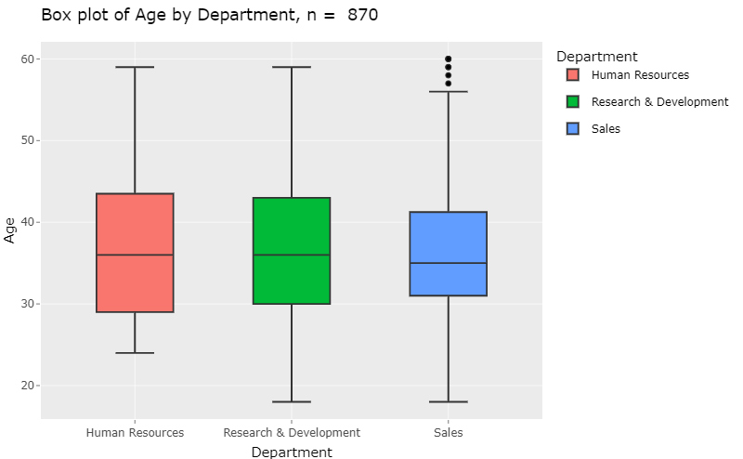
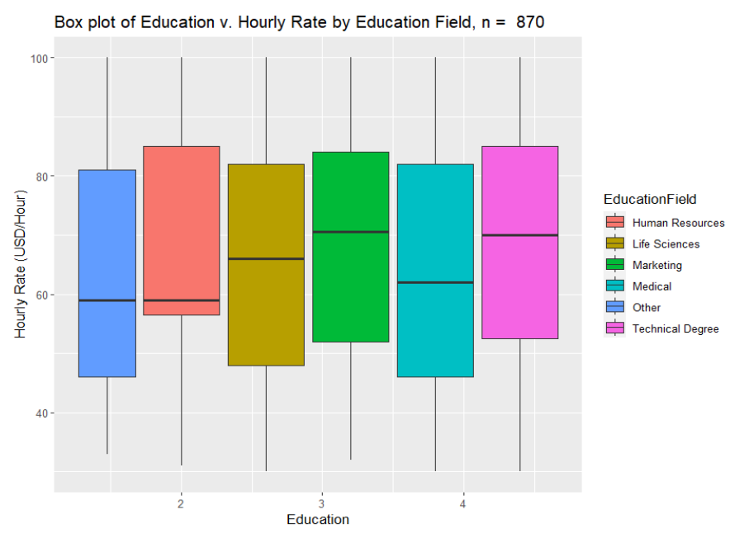
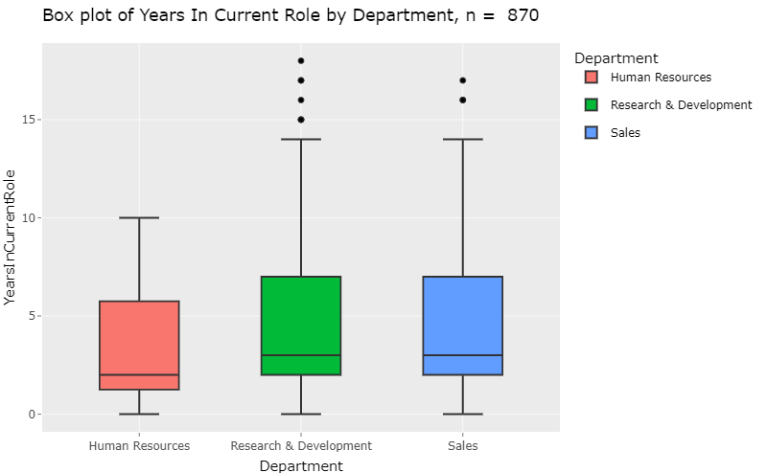

Slide 5

Job Specific Trends
Exploratory Data Analysis

Slide 6
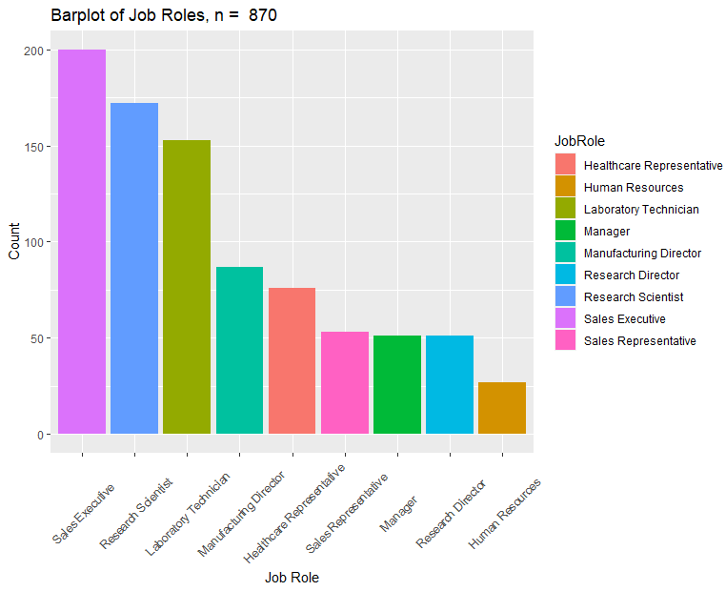

Slide 7
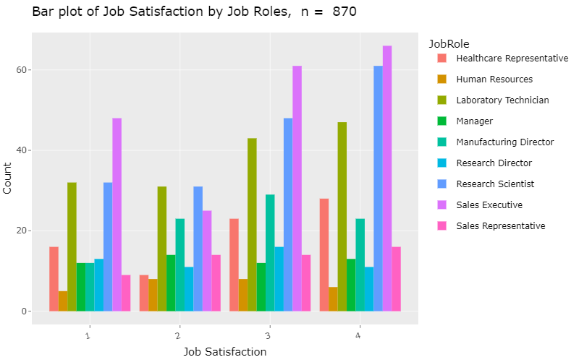

Slide 8
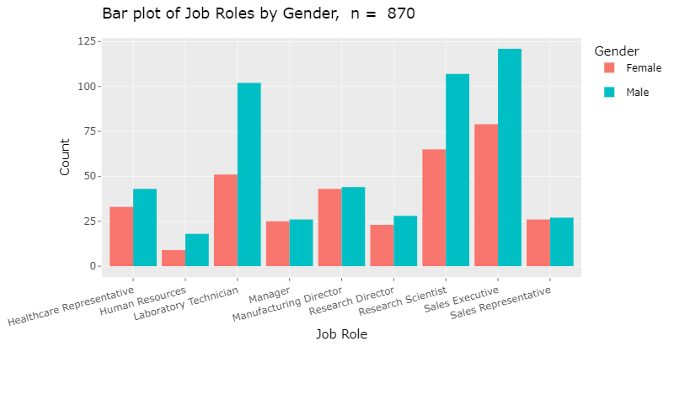

Slide 9
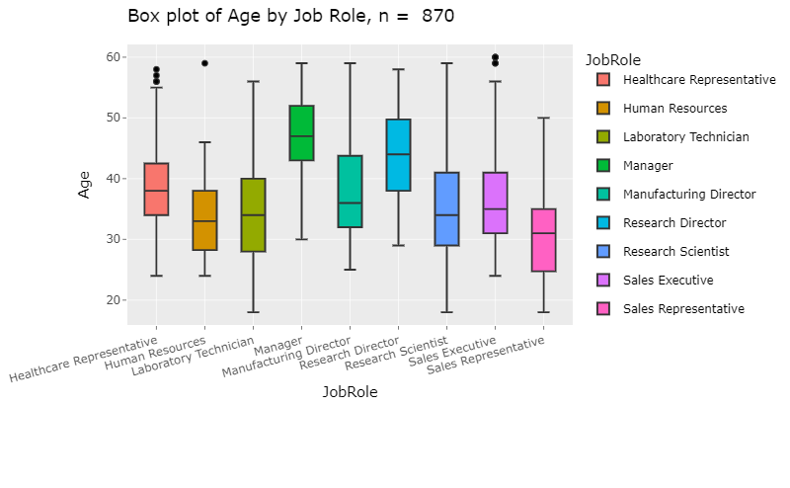
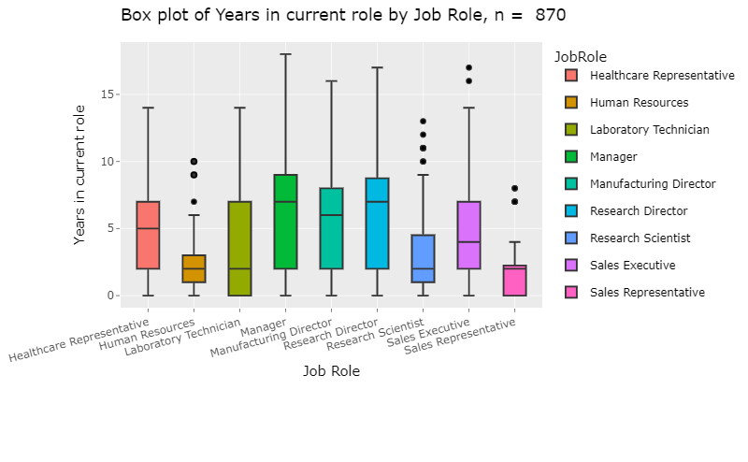

Slide 10
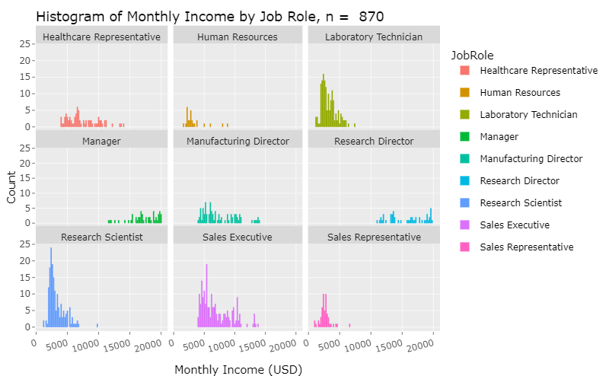
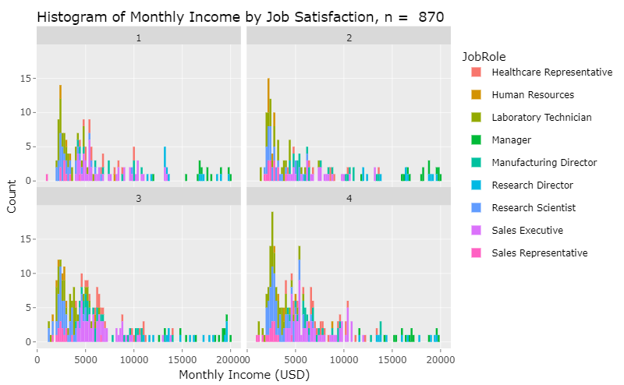

Slide 11
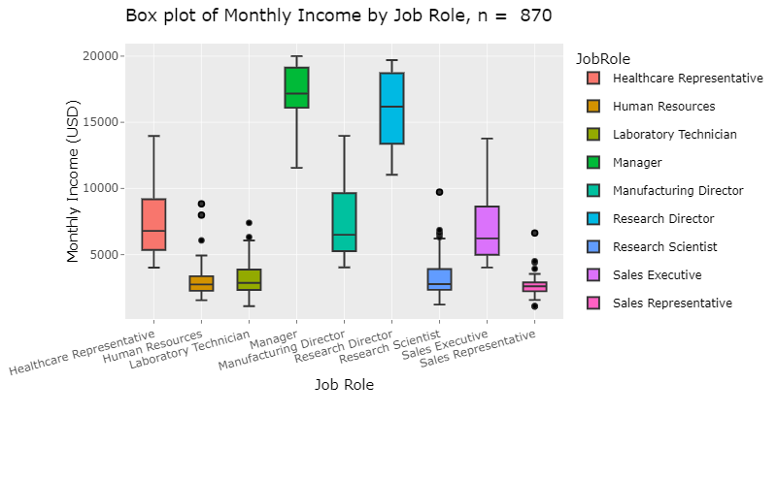

Slide 12

Attrition
Contributing Factors

Slide 13
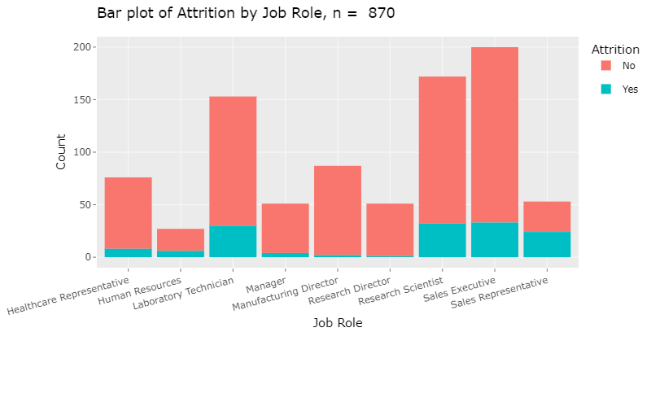
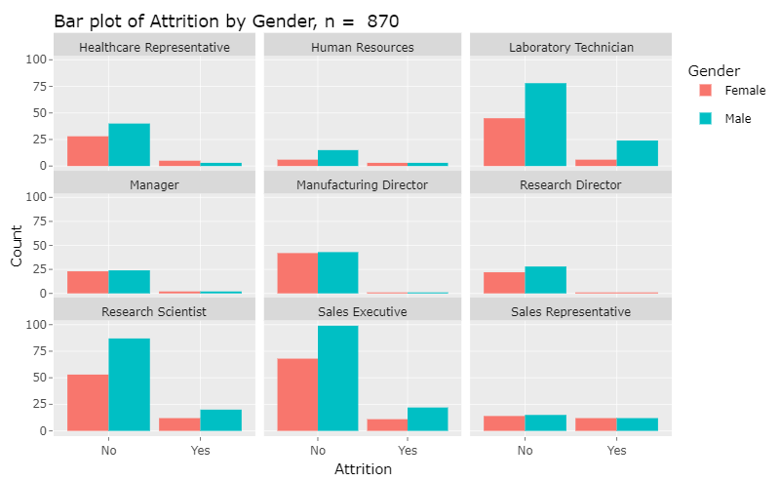

Slide 14
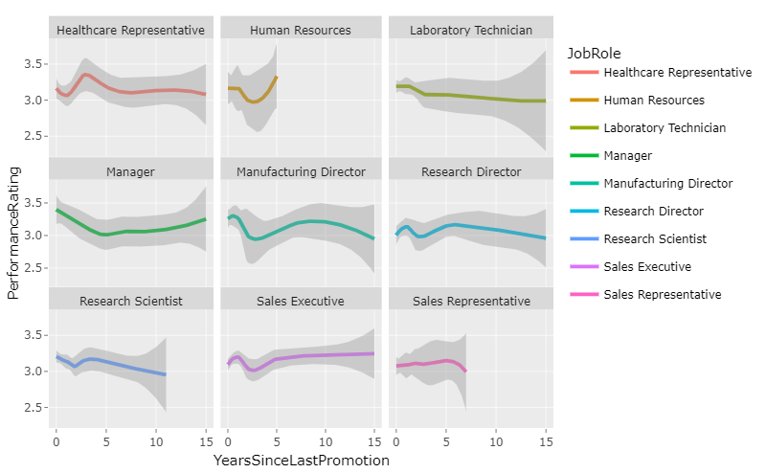
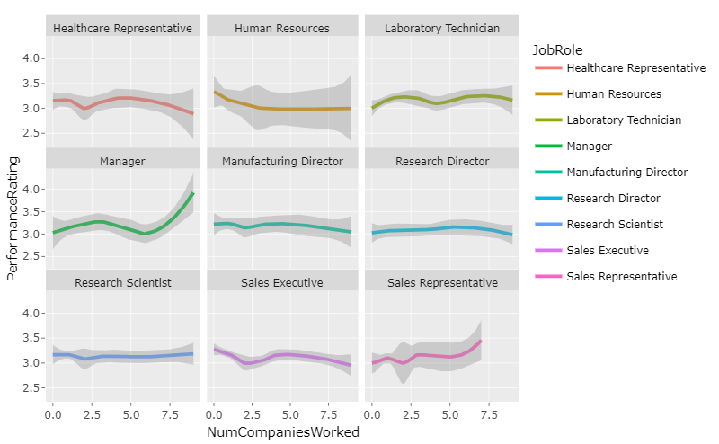
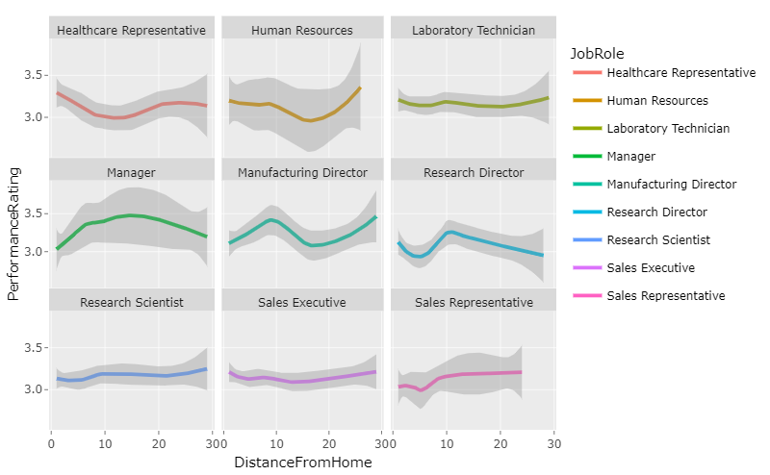

Slide 15

Predictors of Attrition
Naive Bayes Classification

Slide 16
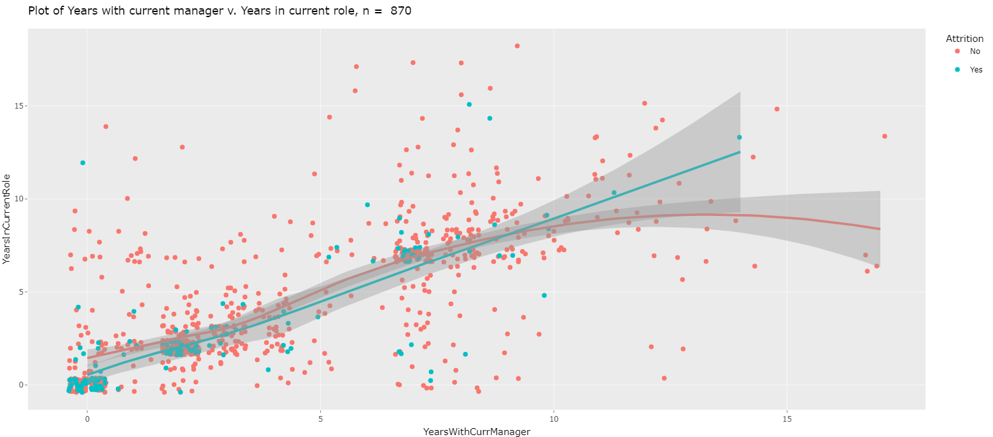

Slide 17
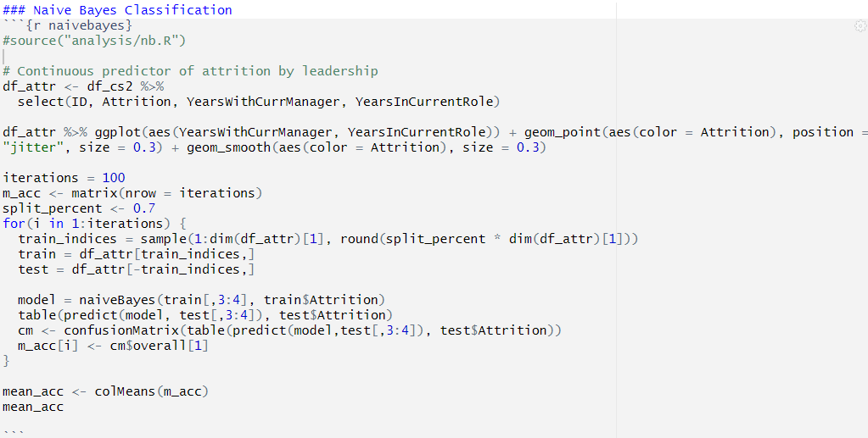
81.6%

Slide 18
APA Citation
FactSet.(2023). Merrill Edge – Profile: PEP – PEPSICO, INC. – Stock Story, Merrill Edge. Accessed 8 December 2023. olui2.fs.ml.com/RIStocksUI/RIStocksStory.aspx?Symbol=PEP#/stock-story/PEP/0.
OpenAI.(2023). ChatGPT response to query on Frito-Lay. ChatGPT.
FritoLay Logo [Online Image]. (2023). Logos | FritoLay. fritolay.com/logos
pep+ logo [Online Image]. (2023). Media | pep+ logo. pepsico.com/mediadownload-item/pep-logo
PepsiCo, Inc. (PEP) (2023). Profile, Summary. Yahoo!Finance. finance.yahoo.com/quote/PEP?p=PEP

Slide 19

Questions & Comments?

